Slide 1
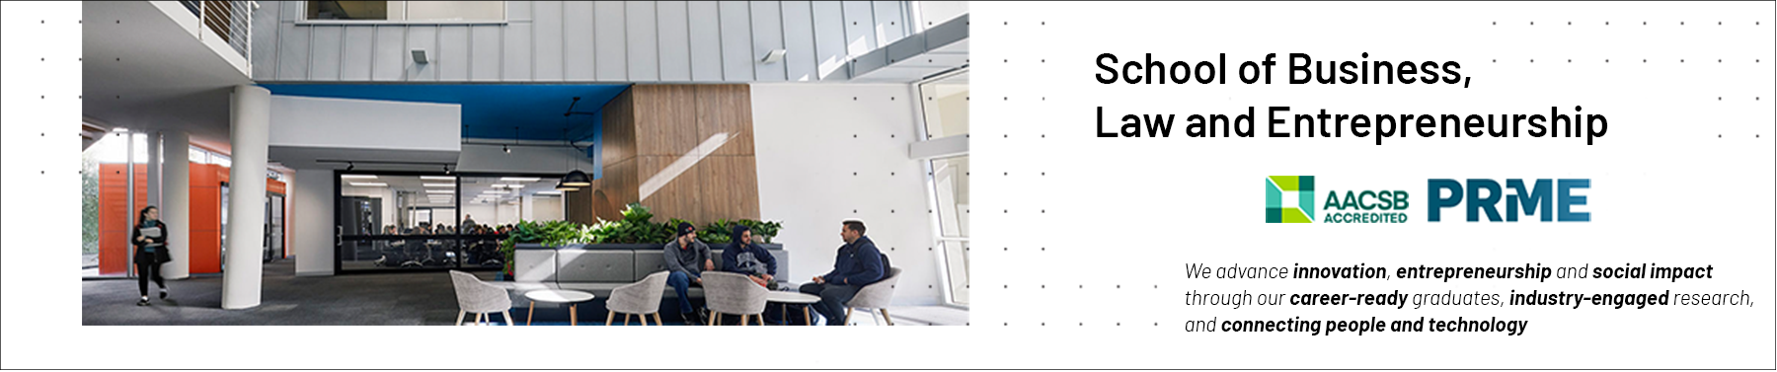

Professional Capabilities for a Digital World
School of Business, Law and Entrepreneurship
INF20028
Presenter: Stuart McLoughlin
Online Learning Materiel: Professionalism / Theory

Slide 2

Roadmap for this session
What we will be covering.
Characteristics of being a professional
How Professionalism relates to ICTs
Benchmarks of professionalism by external accrediting bodies of Swinburne Degrees such as the ACS
Why ethics is an important focus of this unit and a consideration of professionalism
Professional Mindsets, Skillsets & Portfolios, Professional Imposter Syndrome
Unit Learning Outcome (ULOs).
2. Evaluate the role of standards, codes of conduct and legislative/regulatory obligations on the level of professionalism of the ICT industry
3. Review the roles and responsibilities of ICT professionals in organisations and society from a range of perspectives such as work-life balance, mentoring and life-long learning.

Slide 3


Professional? Why?
Lack of Diversity
Notes:
3

Slide 4
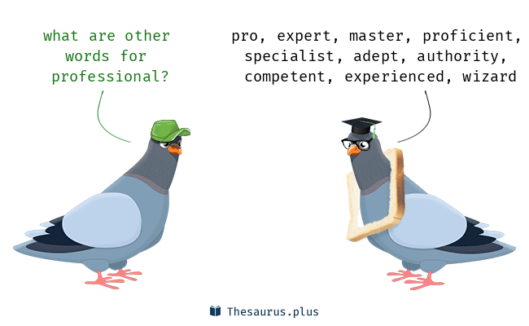
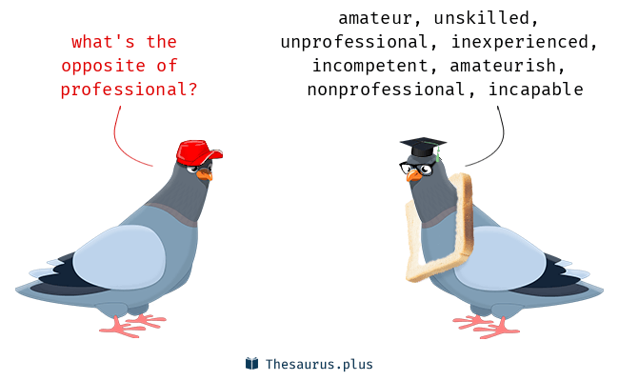
Professional? Does this sound like you?
Notes:
4

Slide 5
Professionalism & ICT
Profession
The profession is the implementation, use and advancement of Information and Communication Technologies.
Professionalism
Professionalism is how you conduct yourself in society, how you utilise your specific ICT skill set.
Professionalisation
Professionalisation in this context has to do with improving the quality of professional practice and products in the ICT domain.
Notes:
5

Slide 6
Where abouts does the Profession of ICT occur?
The workplace is no longer the place where the workers go to work.
Nor is the workplace where the worker is, as digital work is independent of a physical place.
The new workplace is where the work lives: the shared digital environment used by a team, the collection of digital collaboration and communication tools that workers navigate as they find ways to get things done.
Deloitte Insights https://www2.deloitte.com/us/en/insights/focus/technology-and-the-future-of-work/supercharging-teams-in-the-digital-workplace.html
Notes:
6

Slide 7
A Professional: The Australian Council of Professions
Someone who has full accountability for their own technical work and responsibilities; whose decisions can impact on the success of projects; who develops business relationships with customers; who must apply fundamental principles in a wide and often unpredictable range of contexts; and, who can analyse, diagnose, design, plan, execute and evaluate work to time, cost and quality targets.
In addition, they can communicate effectively, demonstrate leadership, and keep their skills up to date.
They are creative, innovative, and aware of their impact on social, business and ecological environments.
Their knowledge and actions are able to influence direction within the organisation, their peers and industry”.
Notes:
7

Slide 8
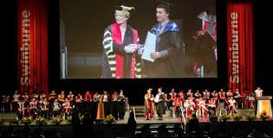
ACS Professionalism Skills of University Graduates –
competence, experience and standards required
Factual and theoretical knowledge of ICT in broad contexts.
Advanced, coherent body of knowledge in a discipline/field involving critical understanding of theories and principles.
Advanced skills, demonstrating mastery and innovation required to solve complex and unpredictable problems in a discipline/field of ICT.
Exercise management and supervision [skills] in contexts of work activities where there is unpredictable change.
Competent to take responsibility for complex technical and professional activities or projects.
Competent to review and develop performance of self and others.
Does this describe you?
Notes:
8

Slide 9
ACS Professionalism Skills of University Graduates –
competence, experience and standards required (2)
A knowledge of ethics – based on the premise that the possibility of unethical behaviour is less likely if a person is educated and trained in the interpretation and application of ethical standards.
A knowledge of the industry with regard to its impact on social business and ecological environments - what we can refer to as contextual awareness or understanding
The functional enterprise skills. Develop and maintain relationships, communicate effectively, demonstrate leadership and continuing professional development.
Where are you in regards to these items?
Notes:
9

Slide 10
Why is the study of ethics important in INF20028?
Three Reasons:
The general business environment
Ethics are a set of moral standards that businesses can use to reach conclusions and make decisions to ensure it is affecting good ethical practice
ICT’s have changed the way in which organisations conduct business
With blurring between private and commercial, in that a lot of your personal data is controlled by commercial organisations
The way in which ICT’s are being embedded in society is changing all the time
This impacts on the way we relate to one another.
Notes:
10

Slide 11



Association of Colleges and Employers in the USA
Business, Engineering and ICT Sciences
Ability to work in a team structure
2. Ability to make decisions and solve problems (tie)
3. Ability to communicate verbally with people inside and outside an organisation
4. Ability to plan, organise and prioritise work
5. Ability to obtain and process information
6. Ability to analyse quantitative data
7. Technical knowledge related to the job
8. Proficiency with computer software programs
9. Ability to create and/or edit written reports
10. Ability to sell and influence others
Notes:
11

Slide 12

Perceptions of Professionalism
Perceptions depend upon who is asking?
How do others perceive me?
behaviour;
in terms of my attitude; and
in terms of my work
How do I want others to perceive me in terms of my:
behaviour;
in terms of my attitude; and
in terms of my work
Notes:
12

Slide 13
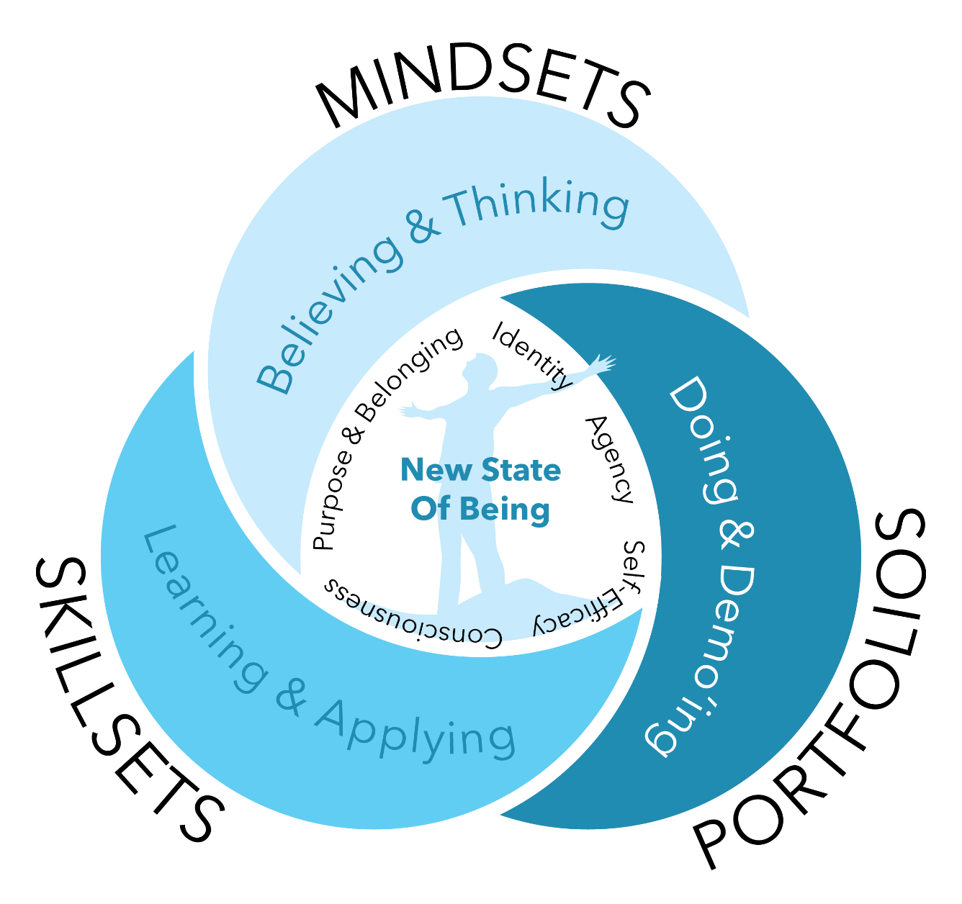
Mindsets / Skillsets / Portfolios
Notes:
13
Infographics source: Khanjan Mehta, LeHigh University. Inquiry to impact Unconference, July 2020.

Slide 14
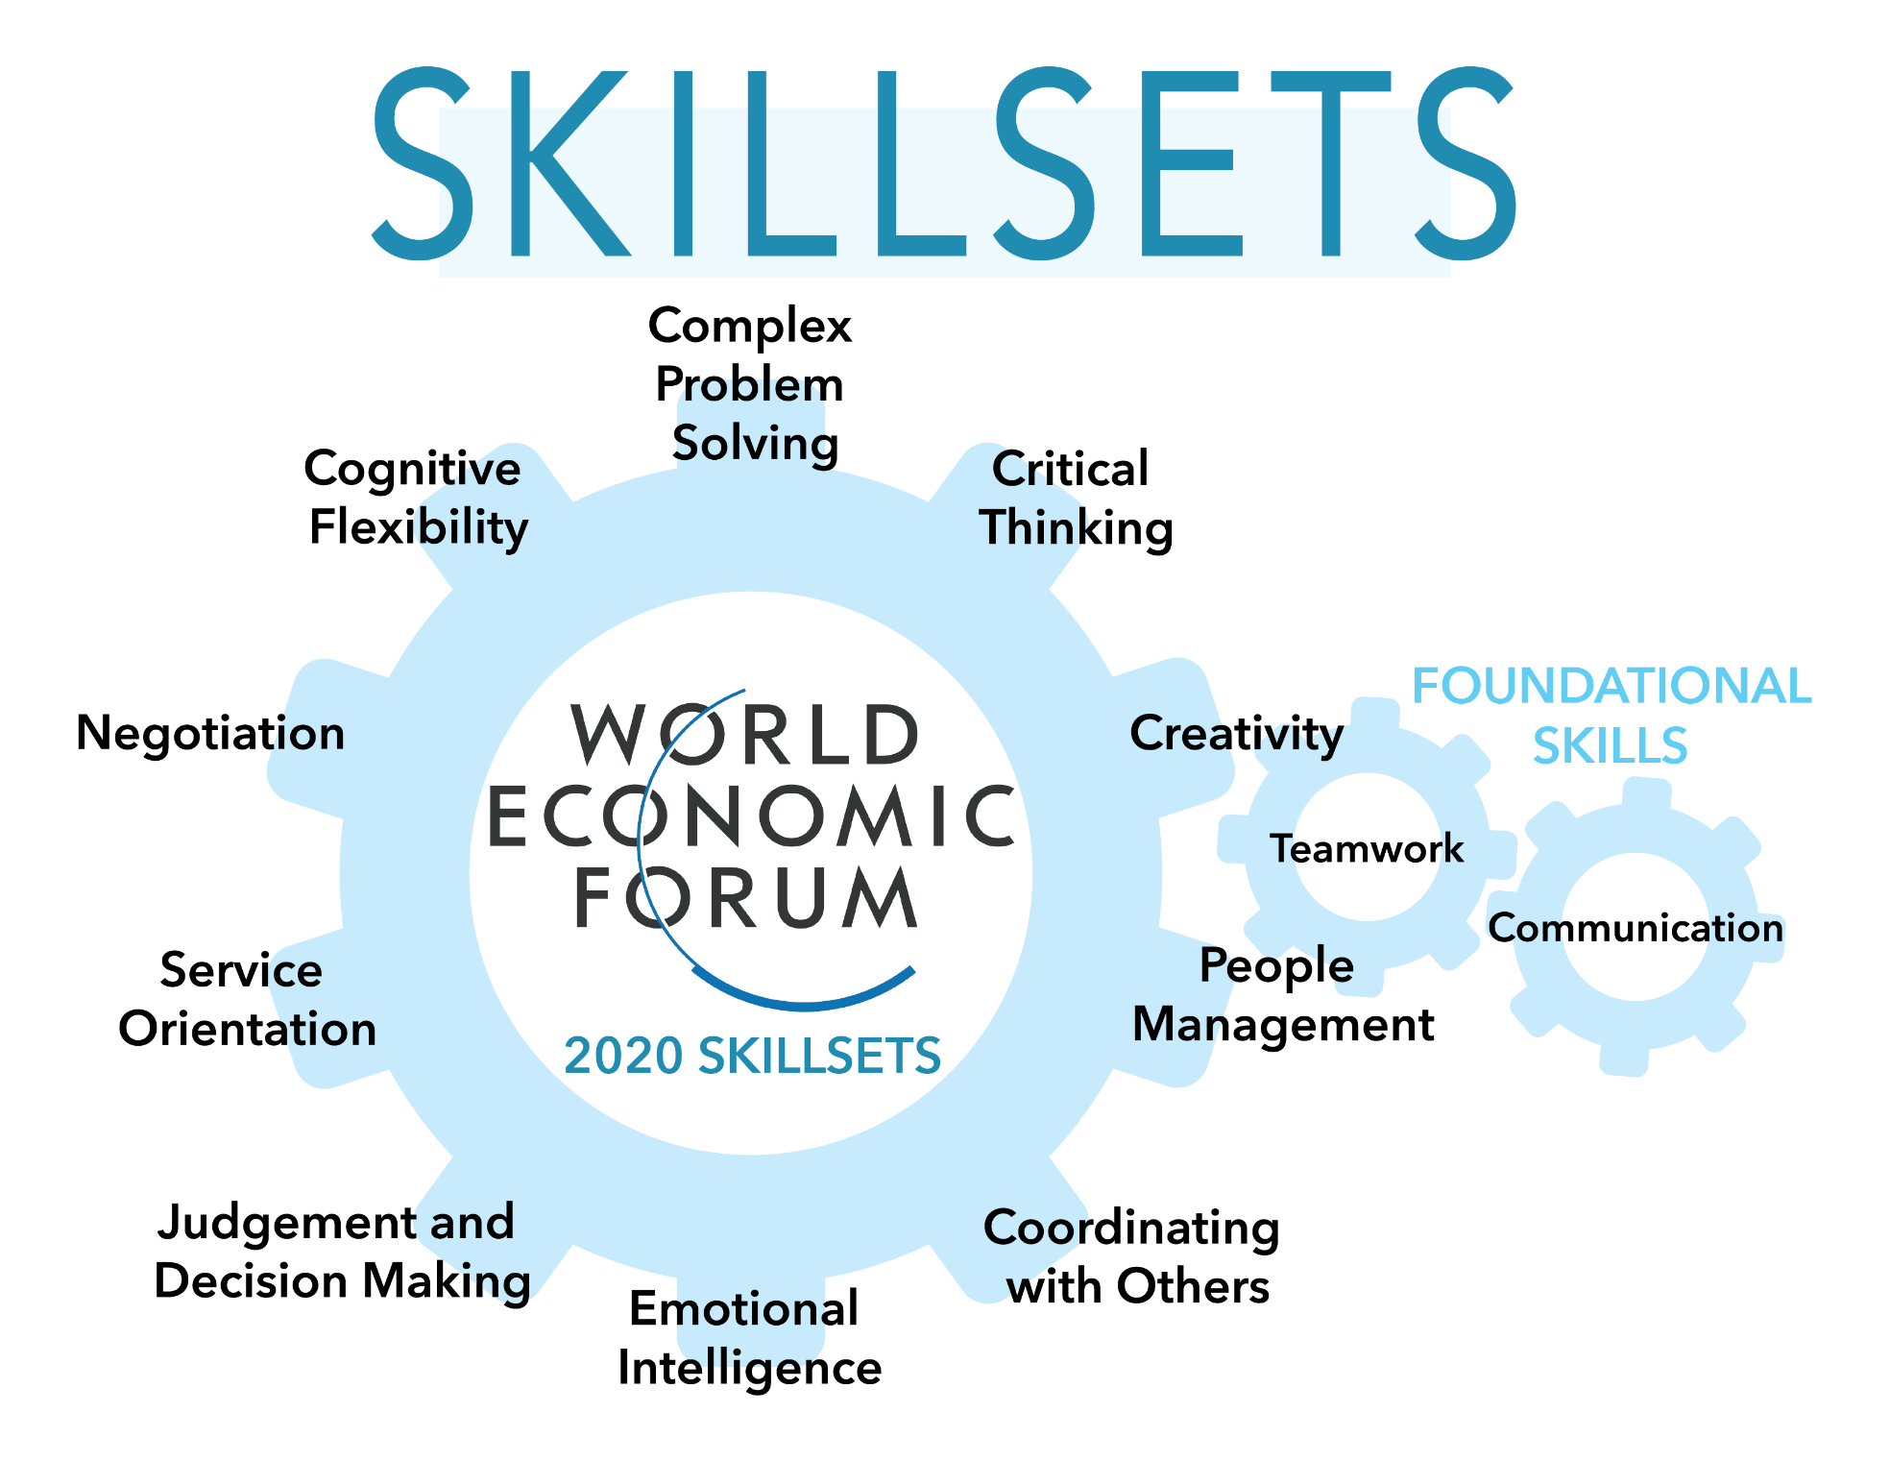
2020 Skillsets
Notes:
14

Slide 15
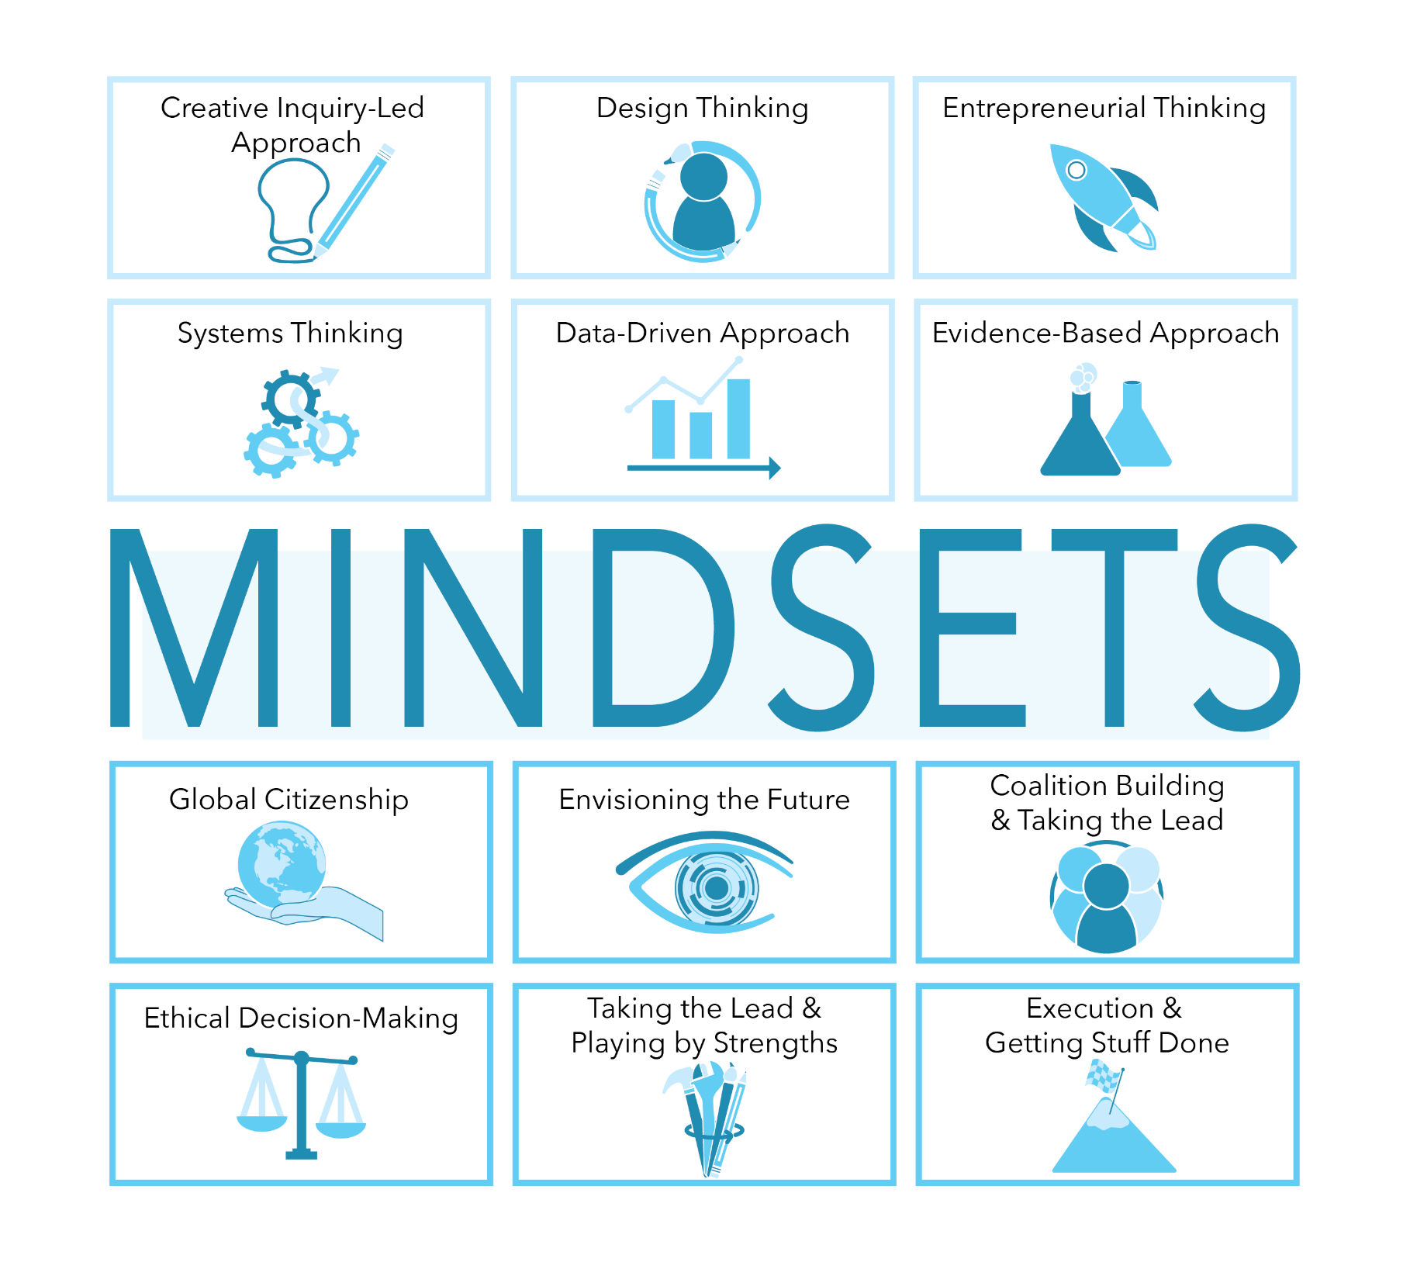
Skillsets as expected attributes of future-ready graduates
Notes:
15

Slide 16
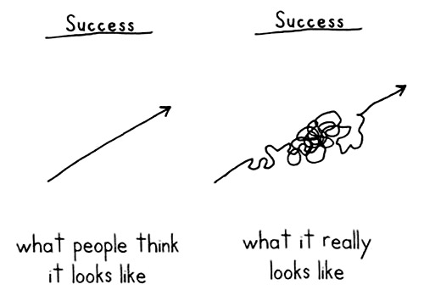
Path to success…Same as professionalism
Notes:
16

Slide 17

Time for a 1 Minute Paper on PROFESSIONALISM
Notes:
17

Slide 18

Let’s review what we have covered
Characteristics of being a professional
How Professionalism relates to ICTs
Benchmarks of professionalism by external accrediting bodies of Swinburne Degrees such as the ACS
Why ethics is an important focus of this unit and a consideration of professionalism
Professional Mindsets, Skillsets & Portfolios

Slide 19

End of the line for this presentation
Notes:
19

Slide 20


